Slide 1
NT-CSS II
Common Support Services

Slide 2
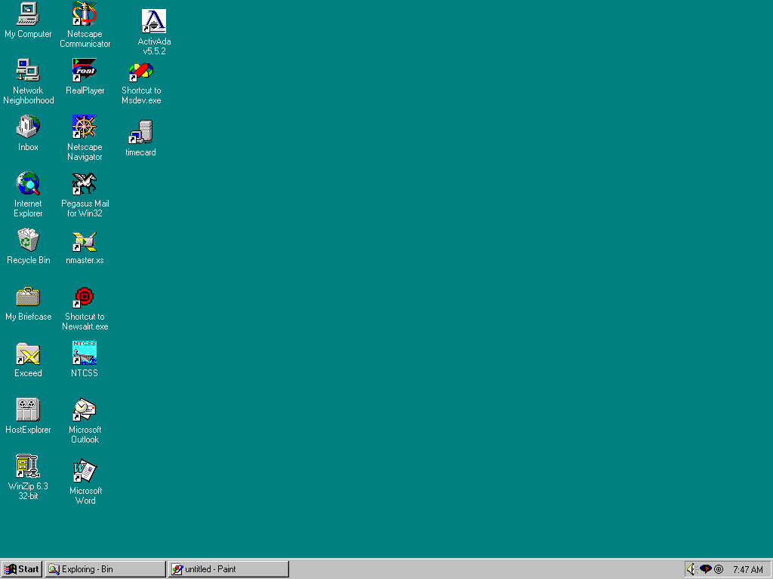
Standard Windows-NT Desktop
NT-CSS Icon

Slide 3
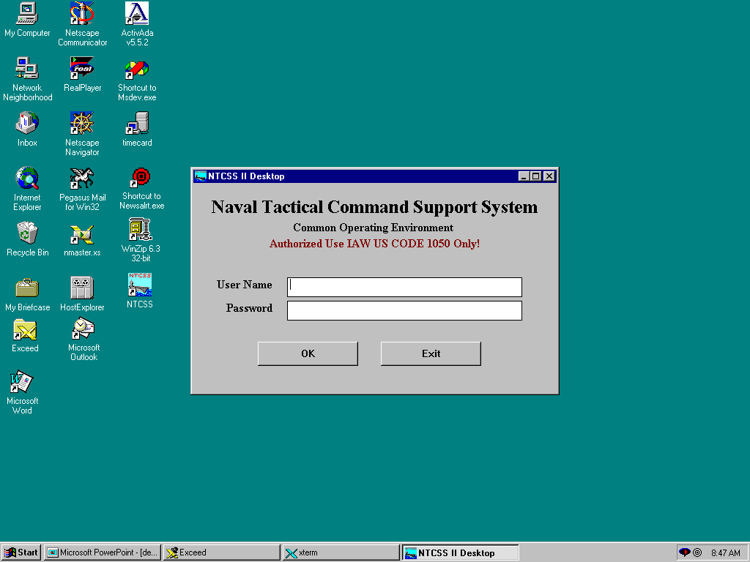
After the NTCSS icon is clicked, this optional login
banner is displayed. It is not required and is
selectable by the site (next slide). If turned off, the user
is transferred directly into the NT-CSS desktop.
After NT-CSS Login, this screen is optional
and selectable by the site. It is not required.
NOTE: This login must occur from a trusted NT domain
which is configurable in NT-CSS.

Slide 4
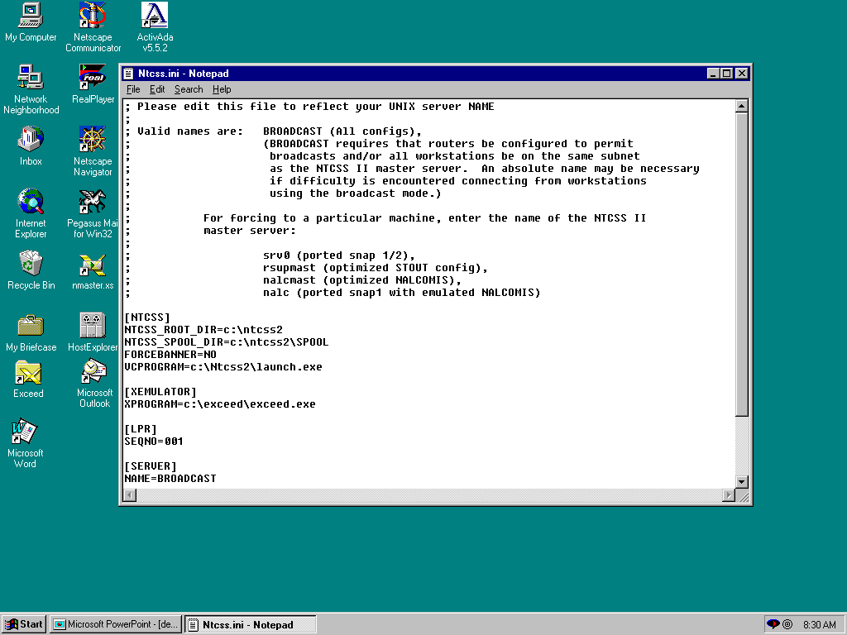
To eliminate the the login
banner, edit the \winnt\ntcss.ini
file and change the “FORCEBANNER”
entry to “NO” as in this example.

Slide 5
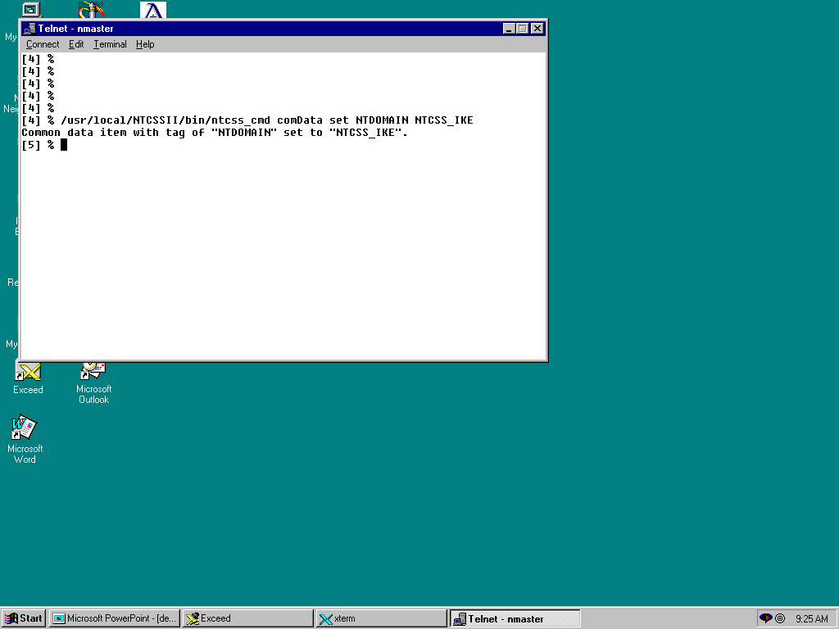
The NTCSS domain may be set on the master
server by using the ntcss_cmd. An example of
setting the NT trusted domain to “NTCSS_IKE”
is demonstrated above. This information is kept
in the /usr/local/NTCSSII/database/SYS_CONF
file.

Slide 6
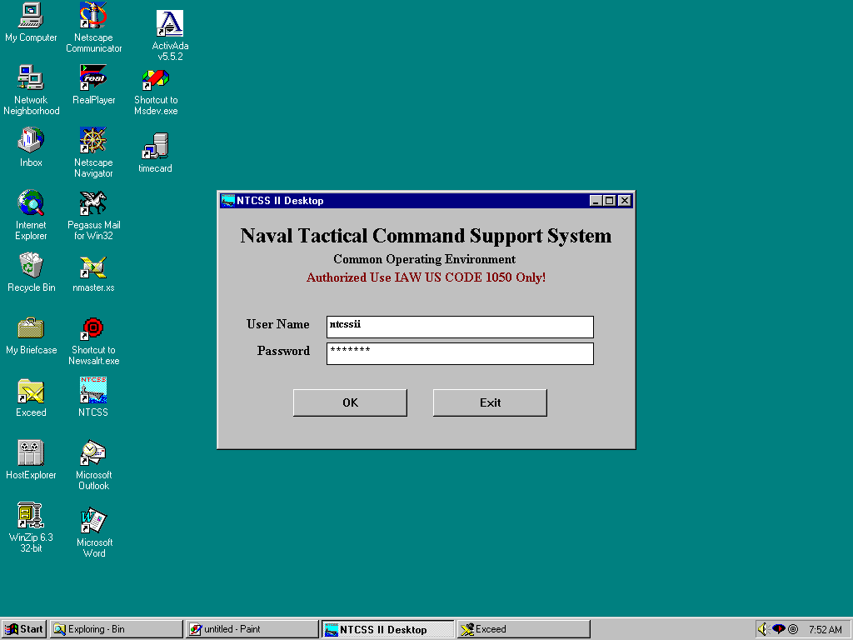
The “ntcssii” user is supplied off-the-shelf
as a System Administrator.

Slide 7
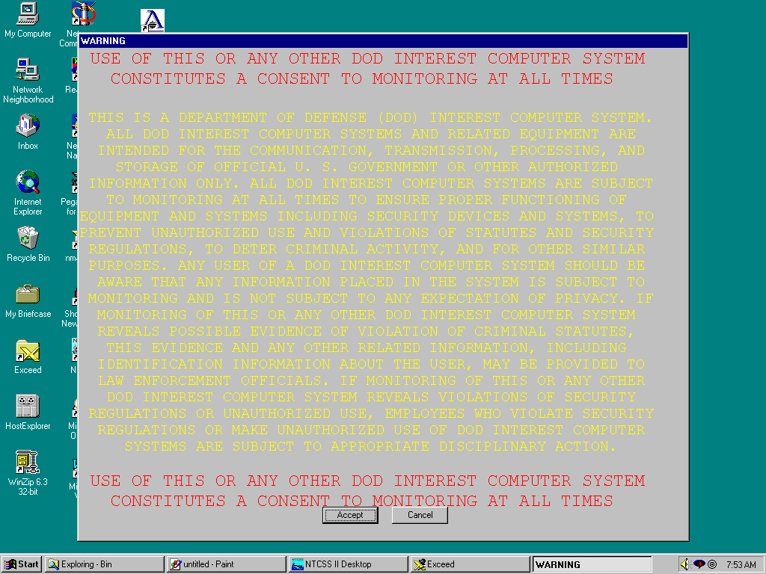
(Mandatory Security Warning
at NT-CSS login)

Slide 8
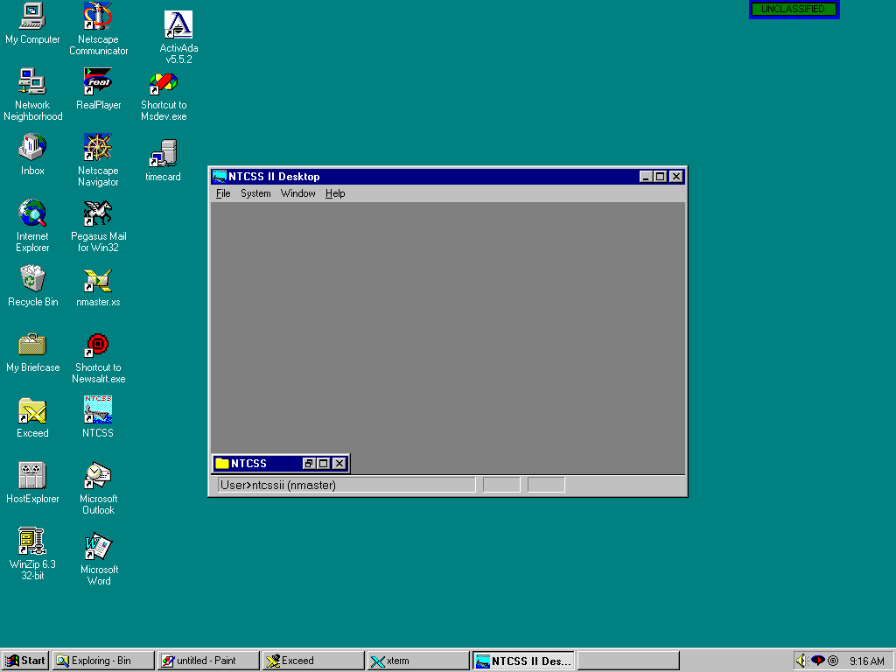
The only default application group
is the “NTCSS” group
Note the
Security
Banner

Slide 9
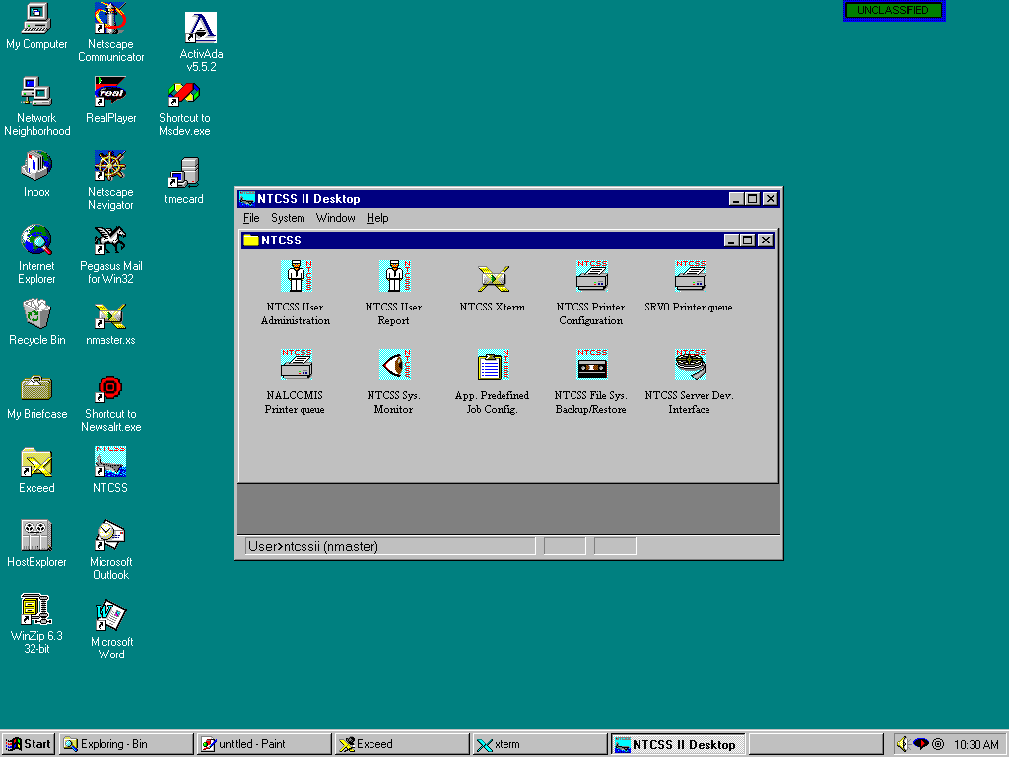
When the NTCSS group is expanded, the System
Administration programs for this particular
site are displayed. This example is for a SNAP I
Ported configuration.

Slide 10
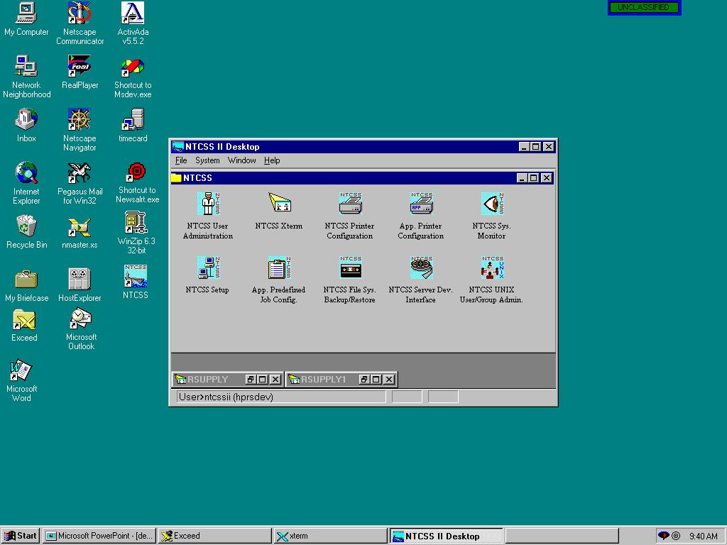
This example is displays the icons that would
be available on an “optimized” site for the NTCSS
Administrator.

Slide 11
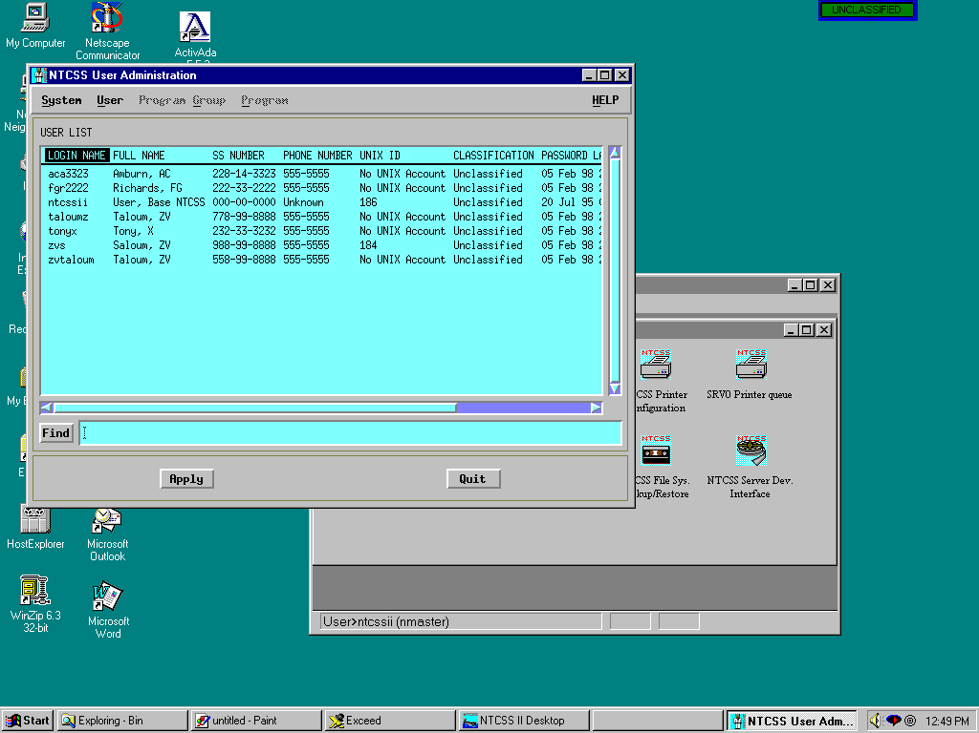
NTCSS User
Administration:
(How we manage users)

Slide 12
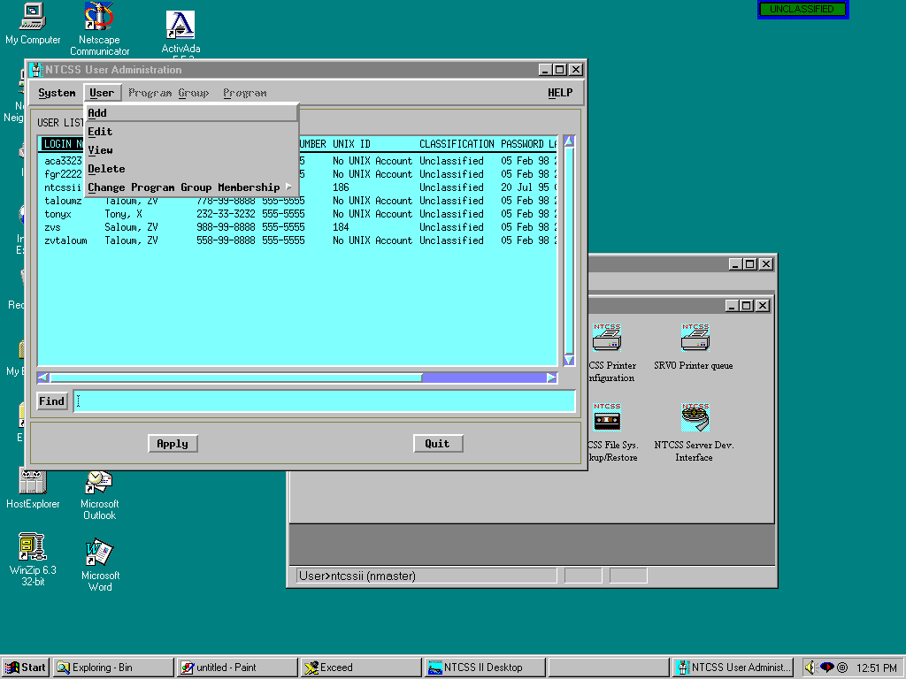
Starting to add a user

Slide 13
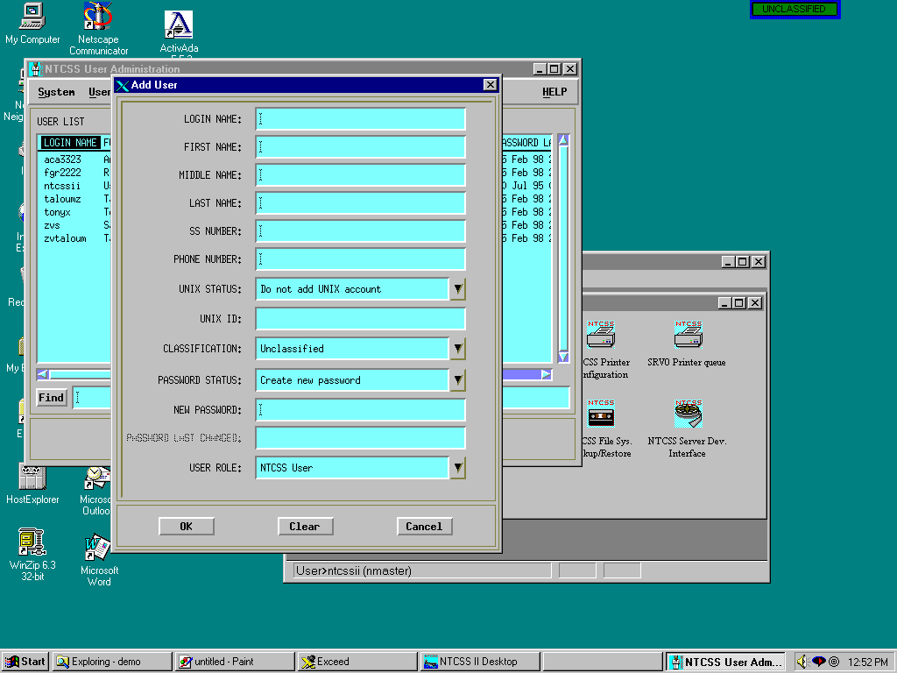
User registration
information is entered

Slide 14
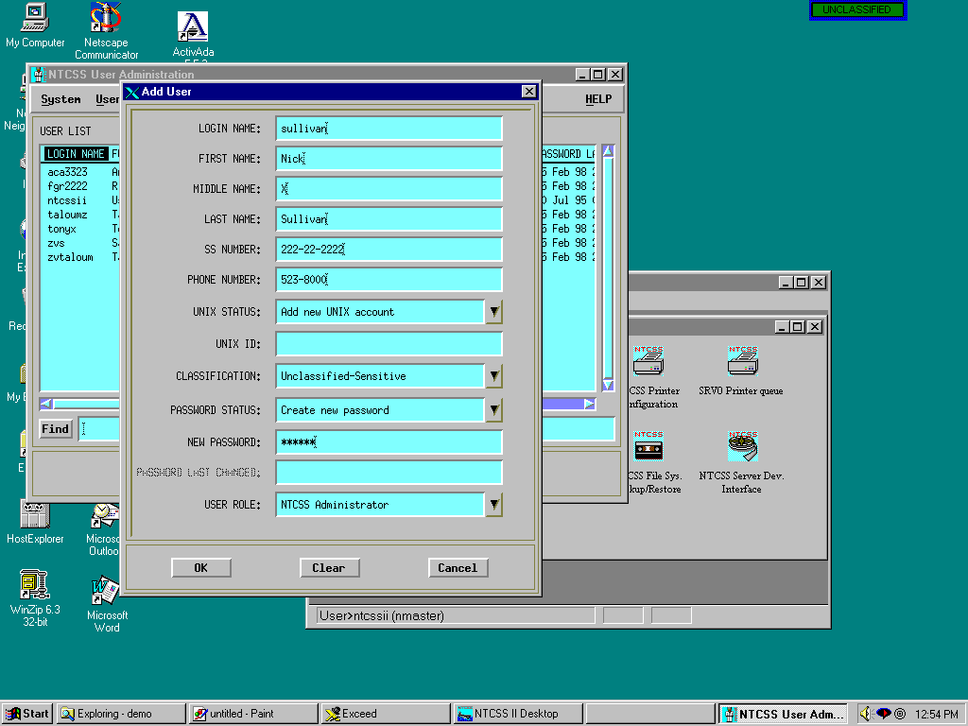
Here, An NTCSS
Administrator named
“sullivan” is created

Slide 15
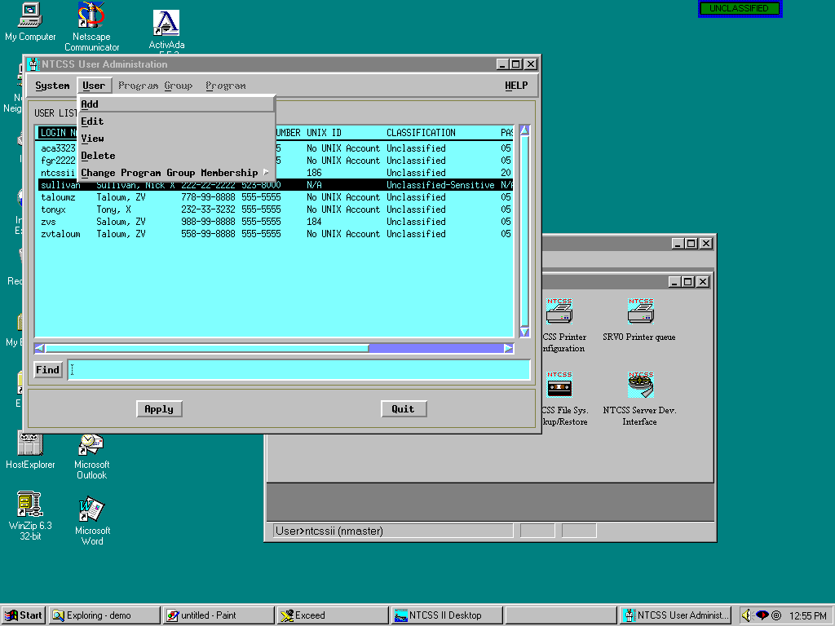
Now the user must be
given some applications
that can be run at
login. (Membership)

Slide 16
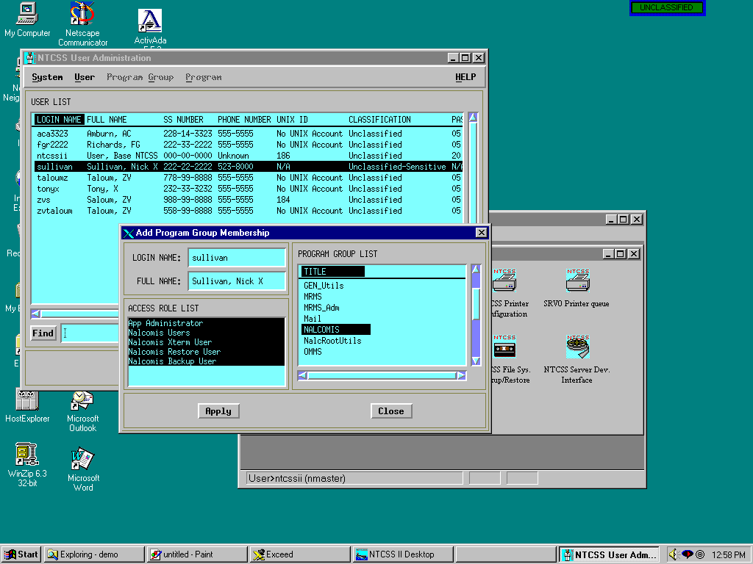
The user is given
“NALCOMIS”,
“OMMS”, “SUADPS”
and other applications

Slide 17
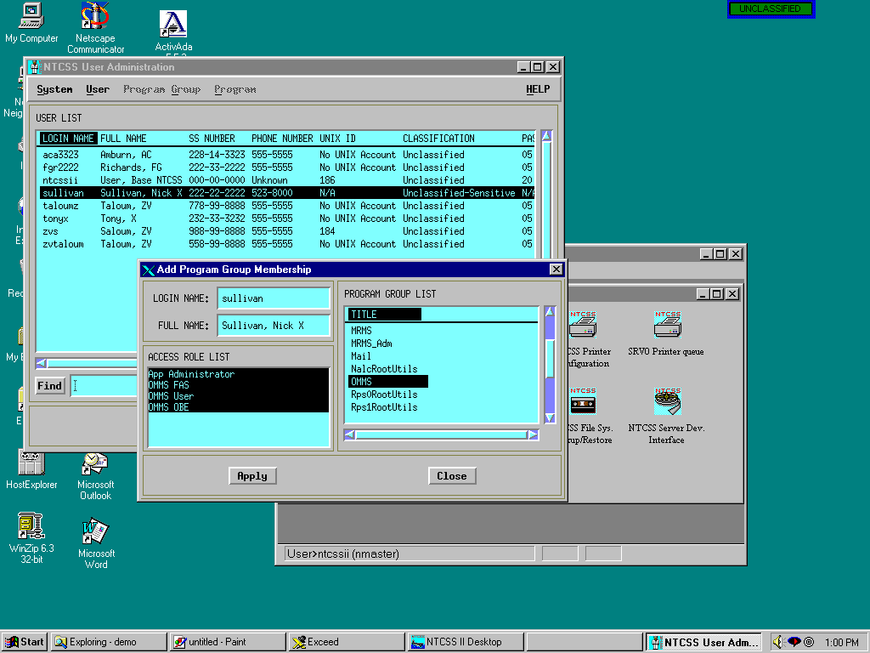
“OMMS”

Slide 18
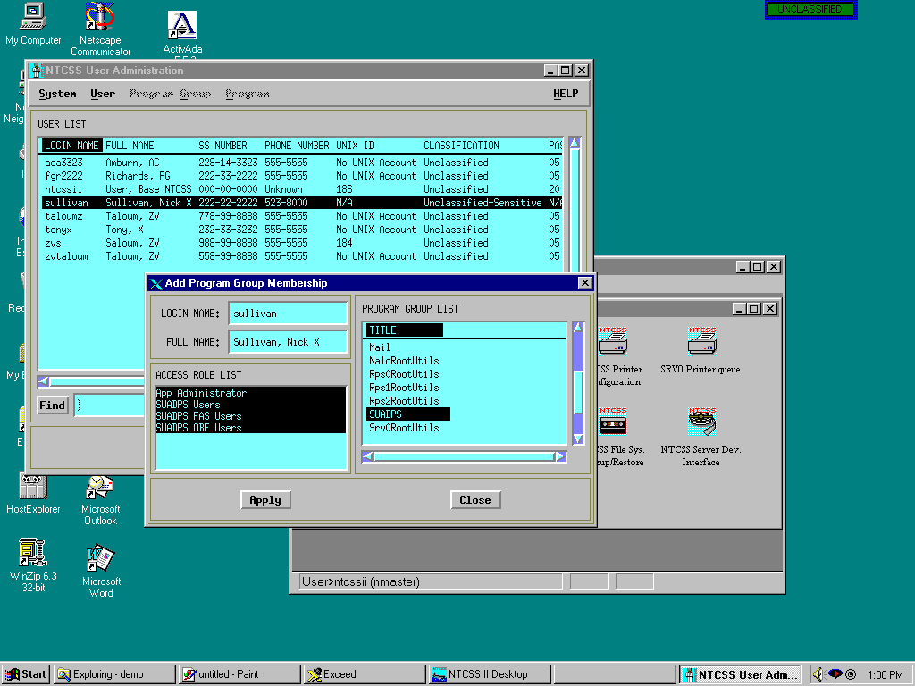
“SUADPS”

Slide 19
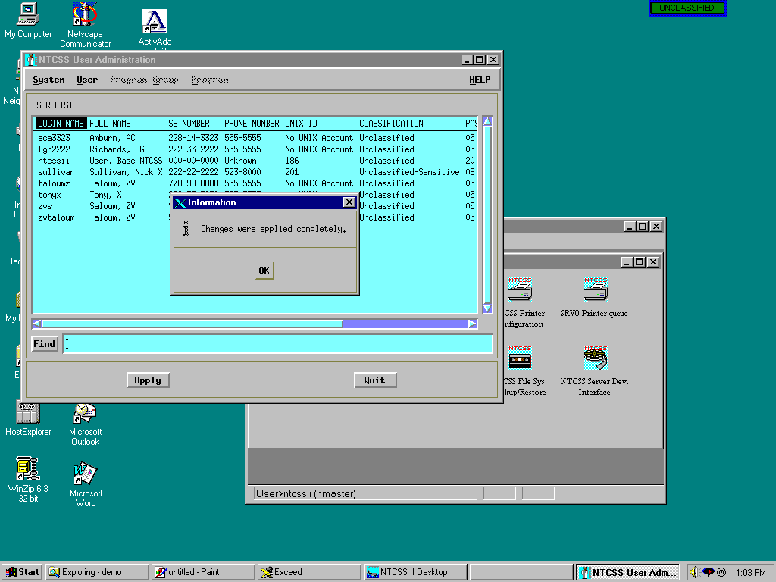
“APPLY” is clicked and
the user is added to
NTCSS and NT
simultaneously. User
directories are created on in all required domains.

Slide 20
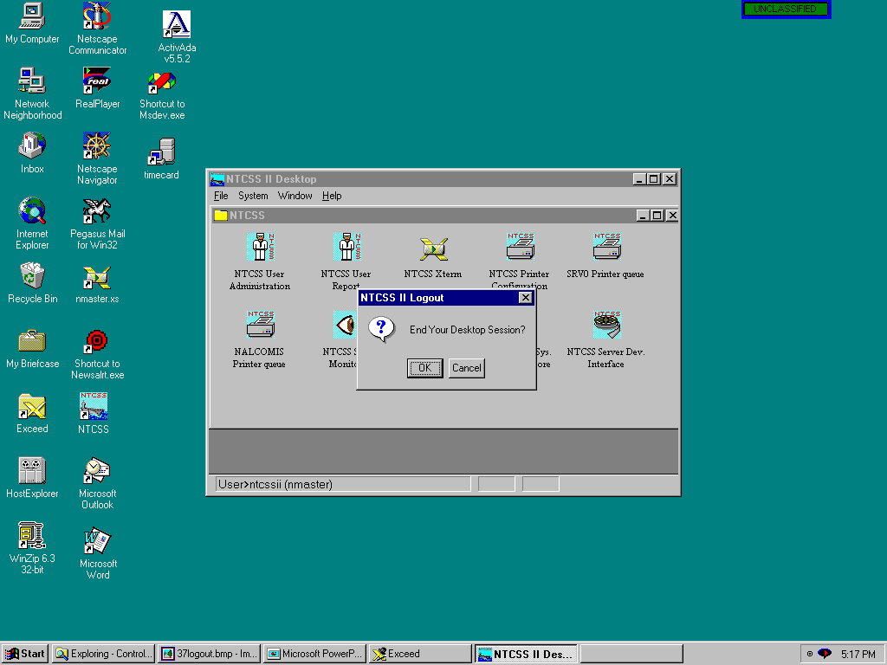
The administrator can now logout to test
the new user

Slide 21
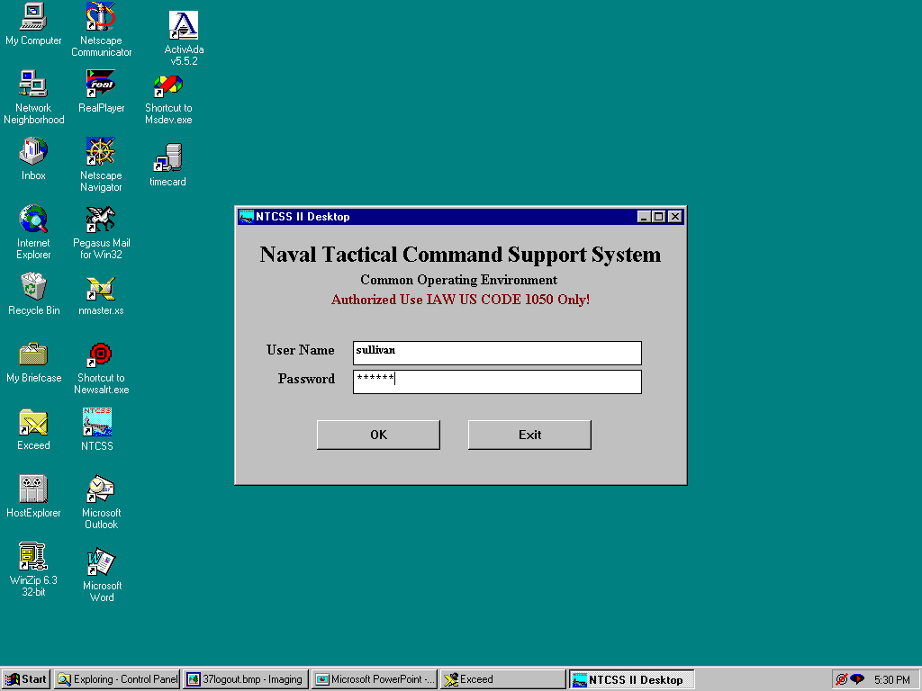
Logging in with the new User-ID
(This could be done at the NT login)

Slide 22
(You get this every time)

Slide 23
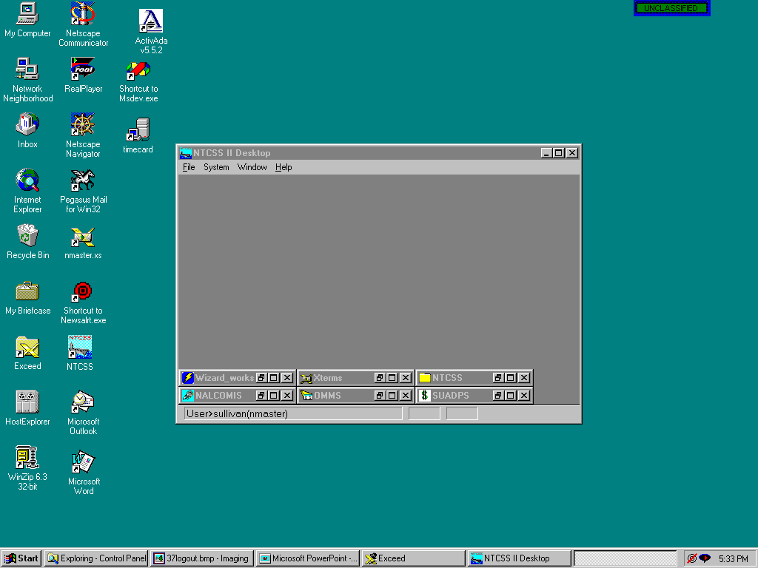
The NTCSS Desktop with some
application groups which were assigned

Slide 24
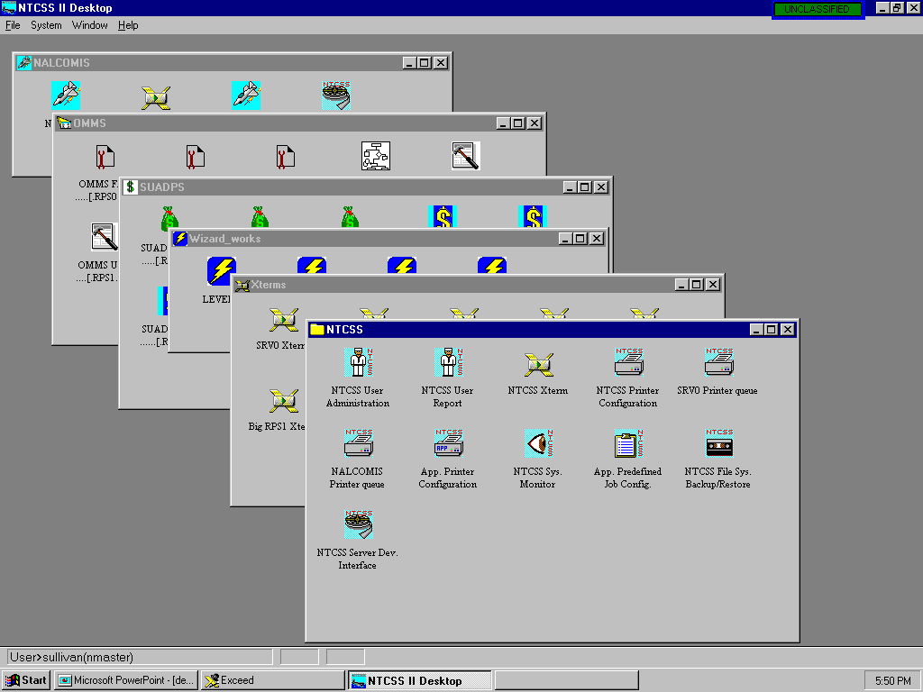
Multiple applications can
be run concurrently

Slide 25
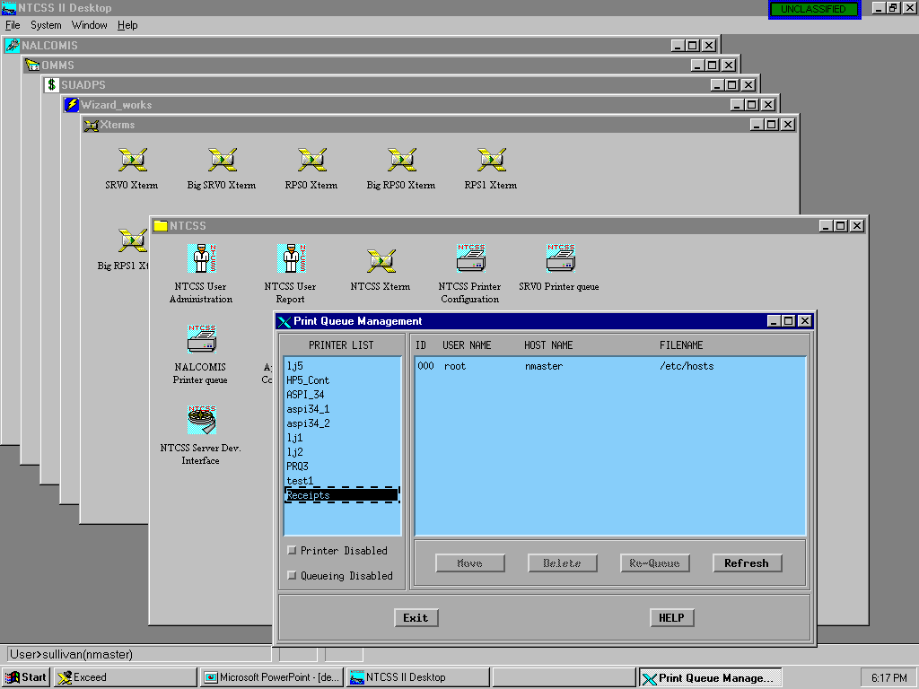
Printer Queue management for Legacy systems
File waiting to print
Printer can be disabled and queuing controlled
On this printer

Slide 26
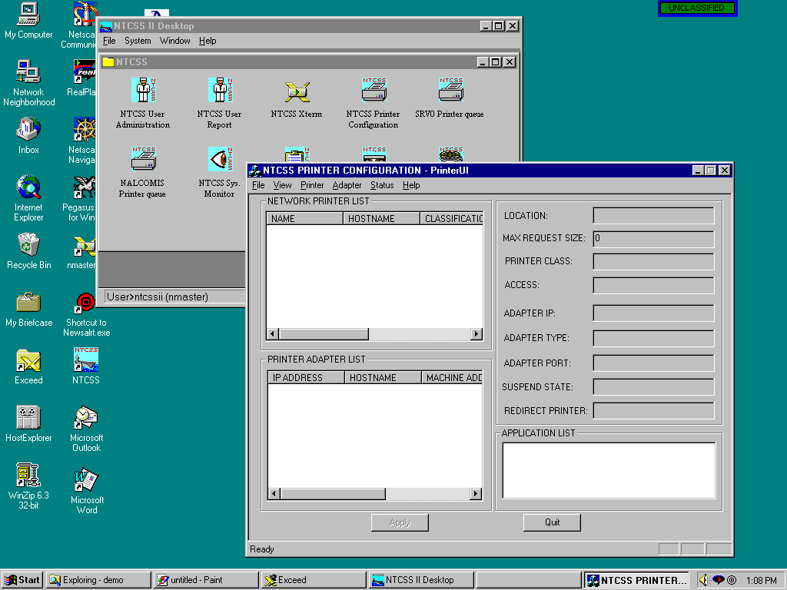
Adding printer adapters and printers
to NTCSS
No adapters or
printers have been
added at this point

Slide 27
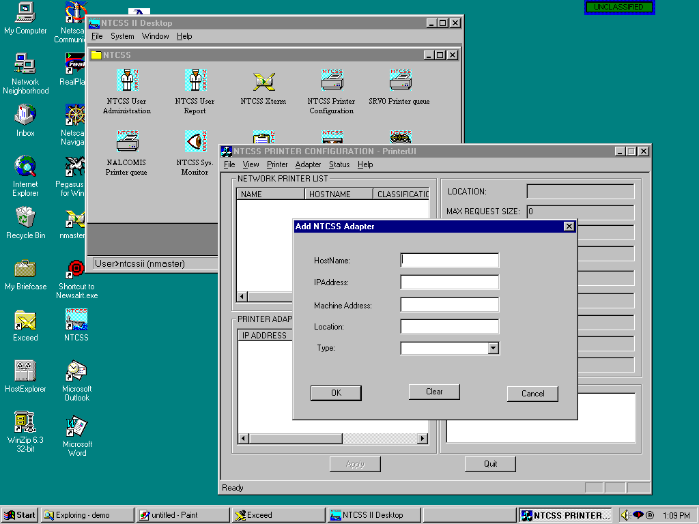
Adding the printer adapter first

Slide 28
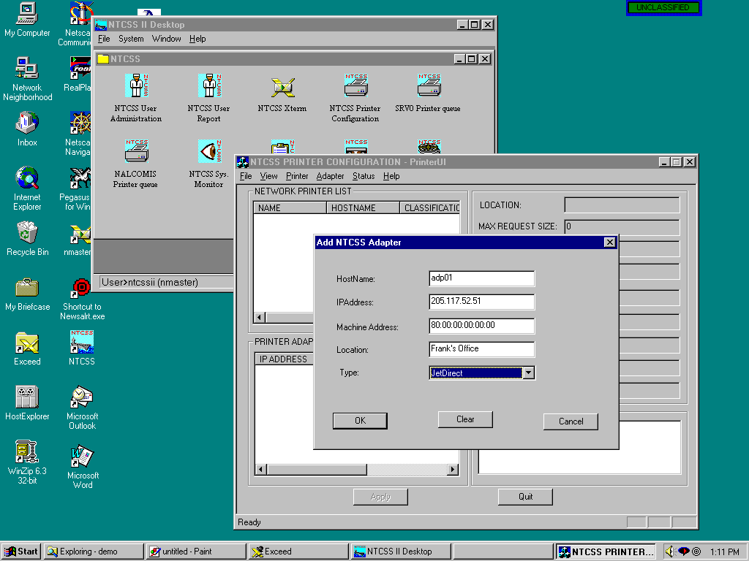
Adapter name, IP address, machine address
and adapter type (JetDirect, Lantronix, etc.)
are added

Slide 29
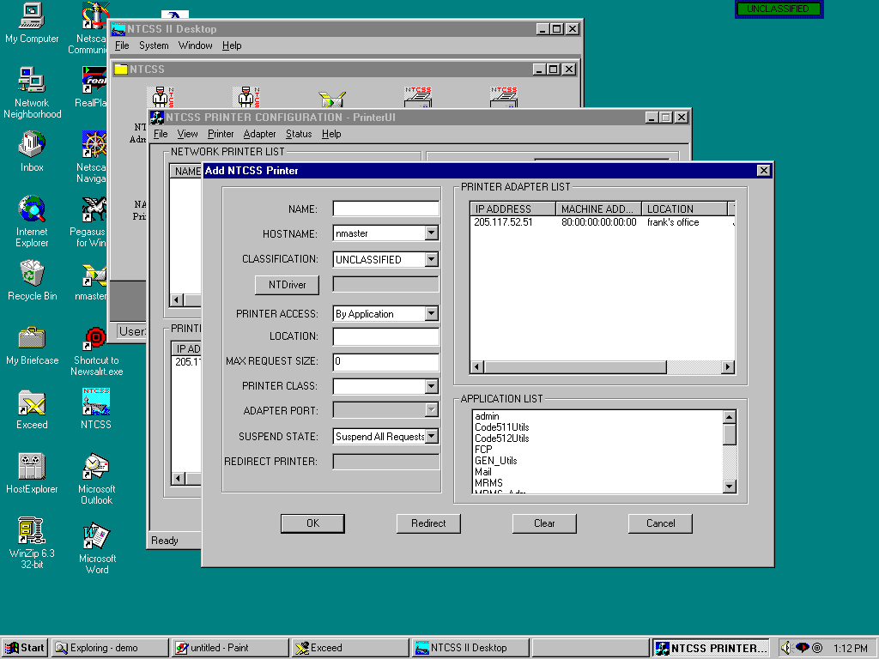
Next a printer can be added to the adapter

Slide 30
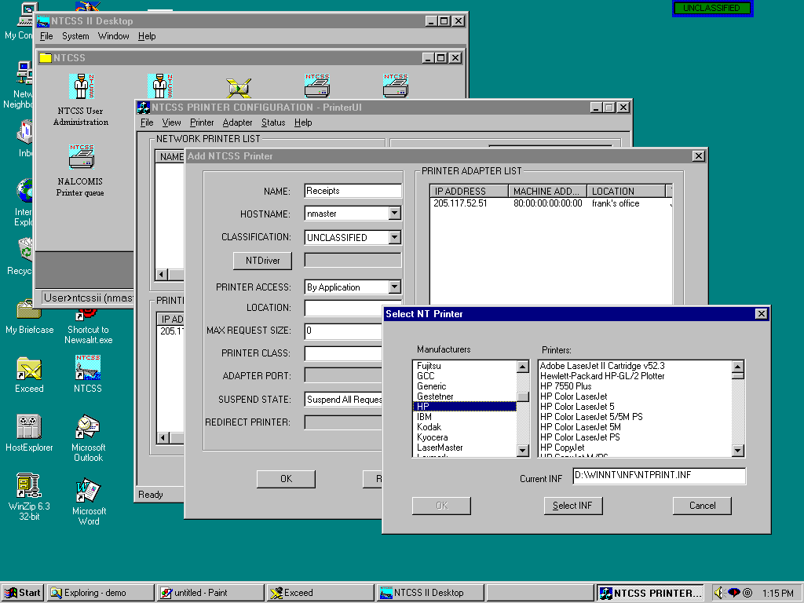
The printer is added on any workstation by an administrator
and it is auto-installed in any other workstation when needed. Here the type of printer is selected.

Slide 31
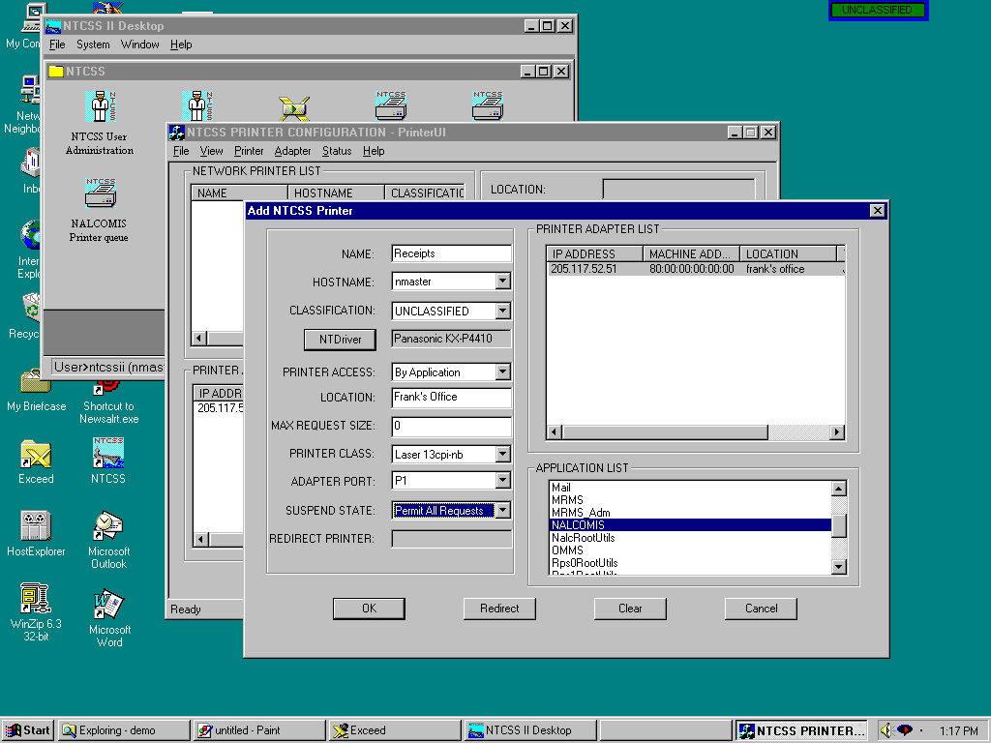
Printers can be dedicated to one or more applications and
can be given classification levels. Output can also be restricted
to volume limitations.

Slide 32
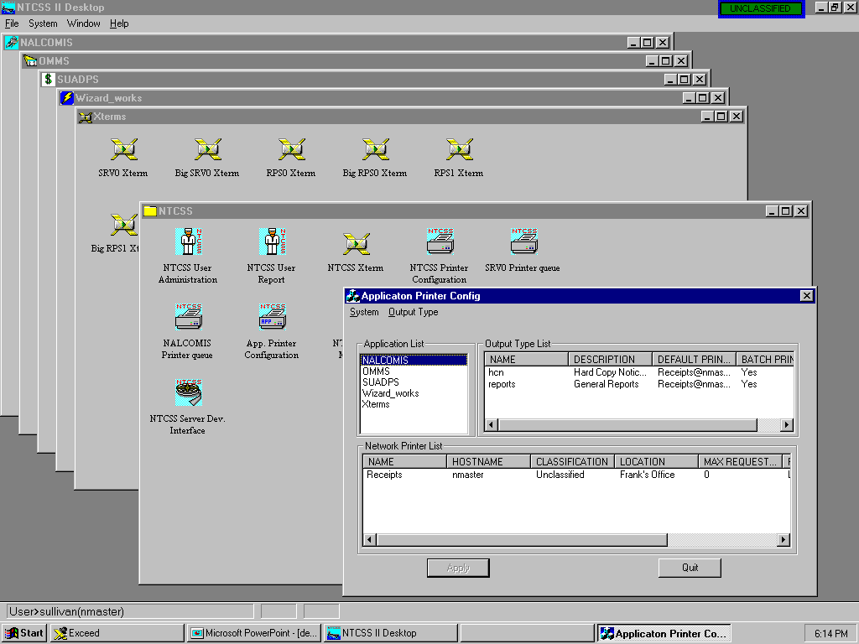
Programs print to “Output types”. This screen establishes the “Output type” to physical printer relationship for the application “NALCOMIS”

Slide 33
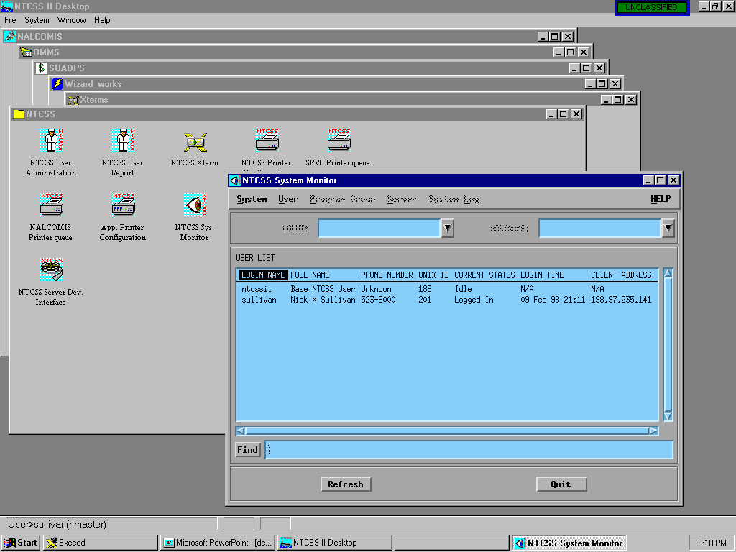
Monitoring Users and System events

Slide 34
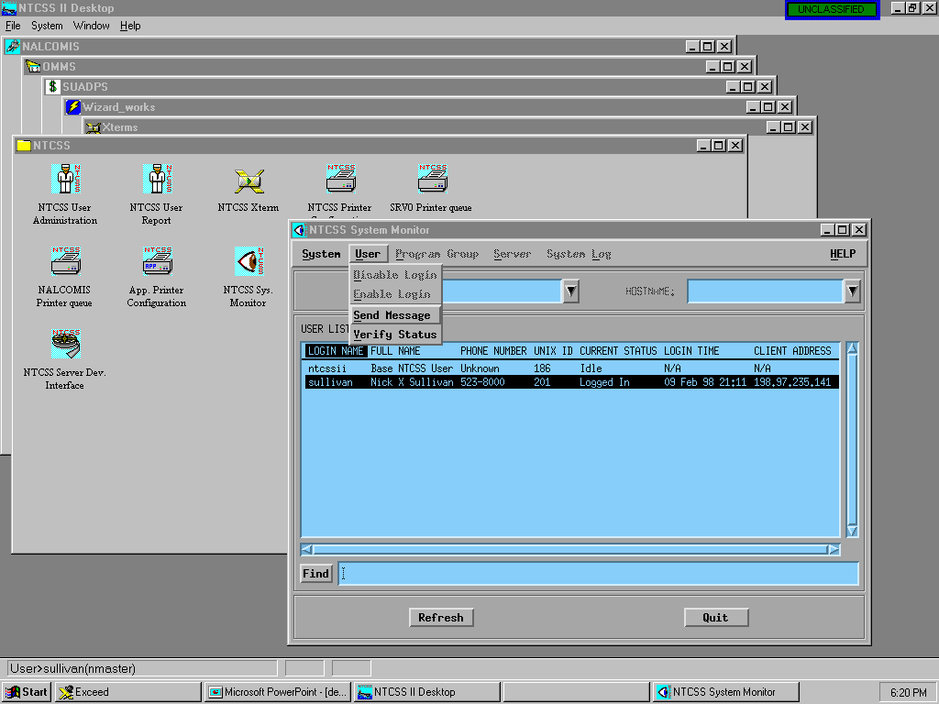
In “user” display mode, the user can be “disabled/enabled”, and can be sent messages
Login status, Login time and originating IP address of the highlighted user

Slide 35
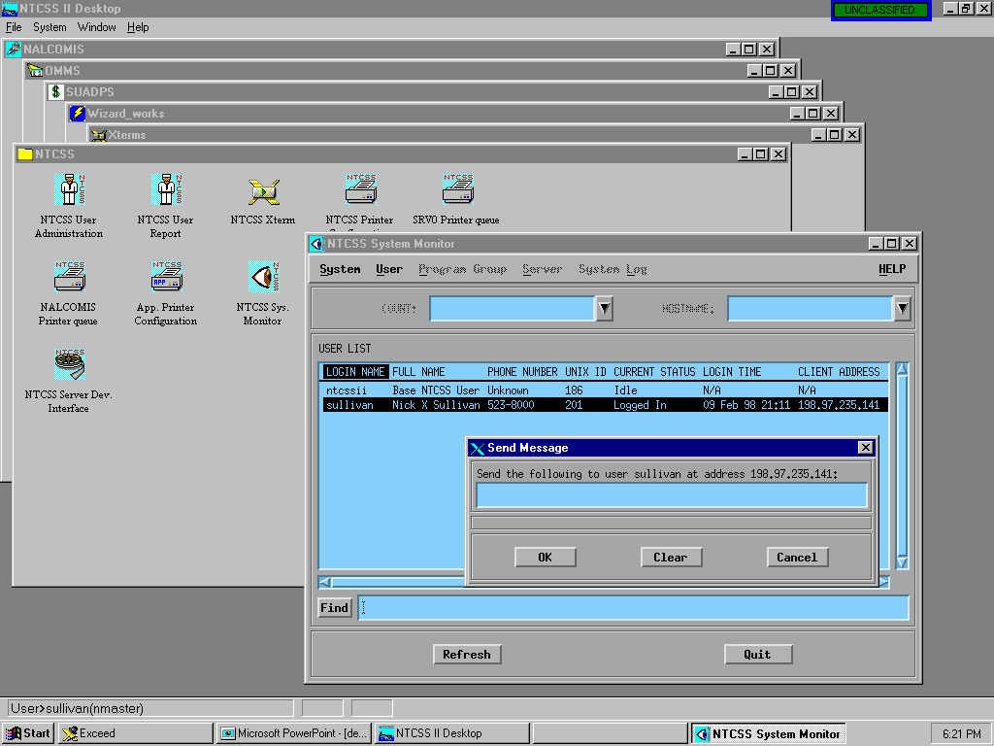
Sending a message to a user

Slide 36
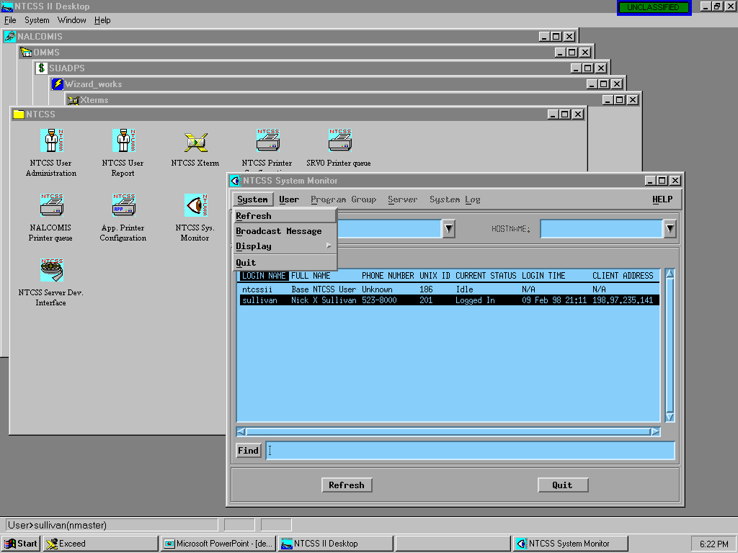
Selecting the display mode

Slide 37
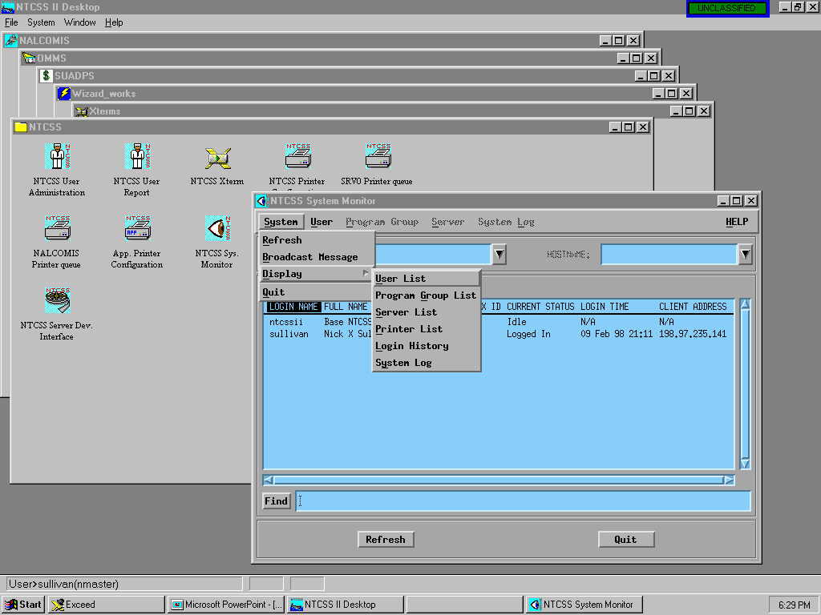
Selecting the Application Group List format

Slide 38
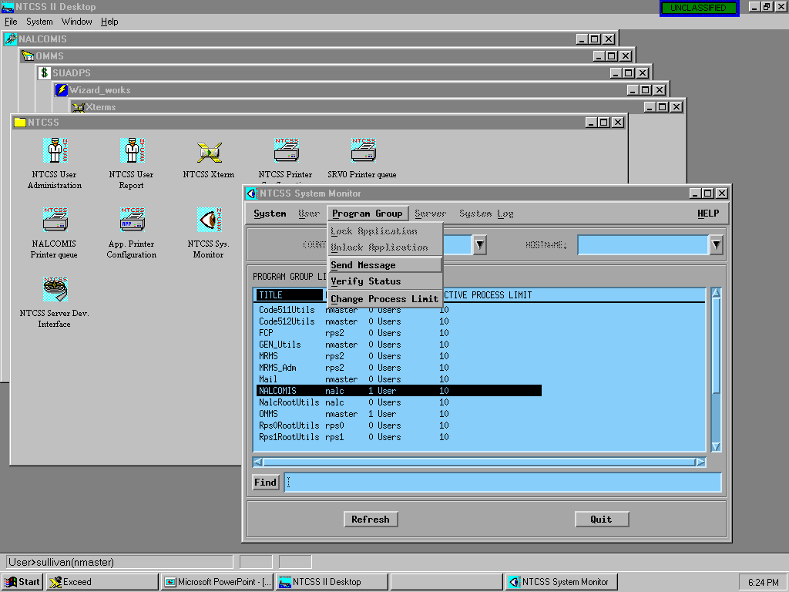
When the group mode is displayed, the group can be locked, and the entire group can be sent a message

Slide 39
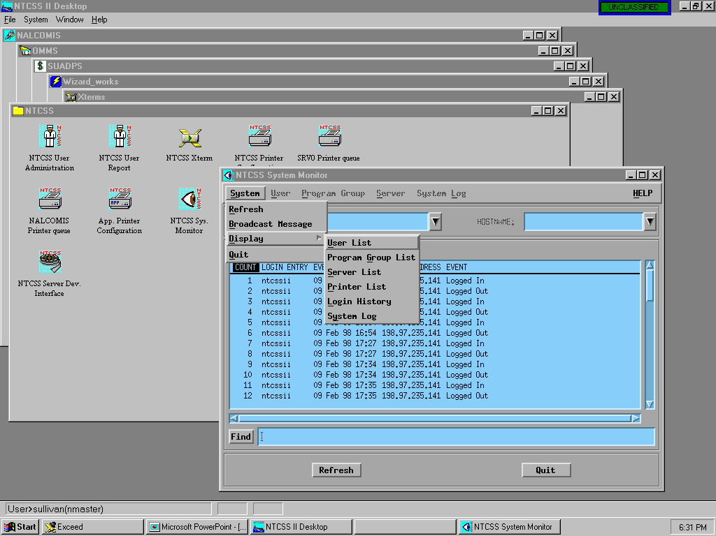
Selecting “Login History” from the Display mode

Slide 40
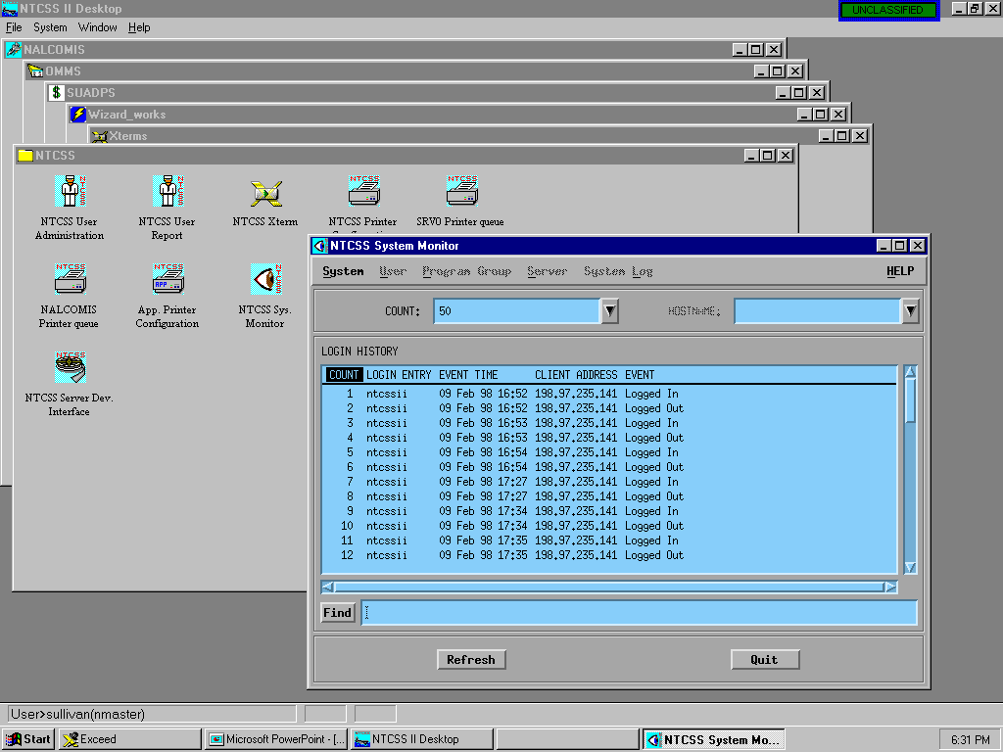
An audit log of logins by NTCSS users with the event time and their originating address

Slide 41
Selecting “System Log” from the display mode

Slide 42
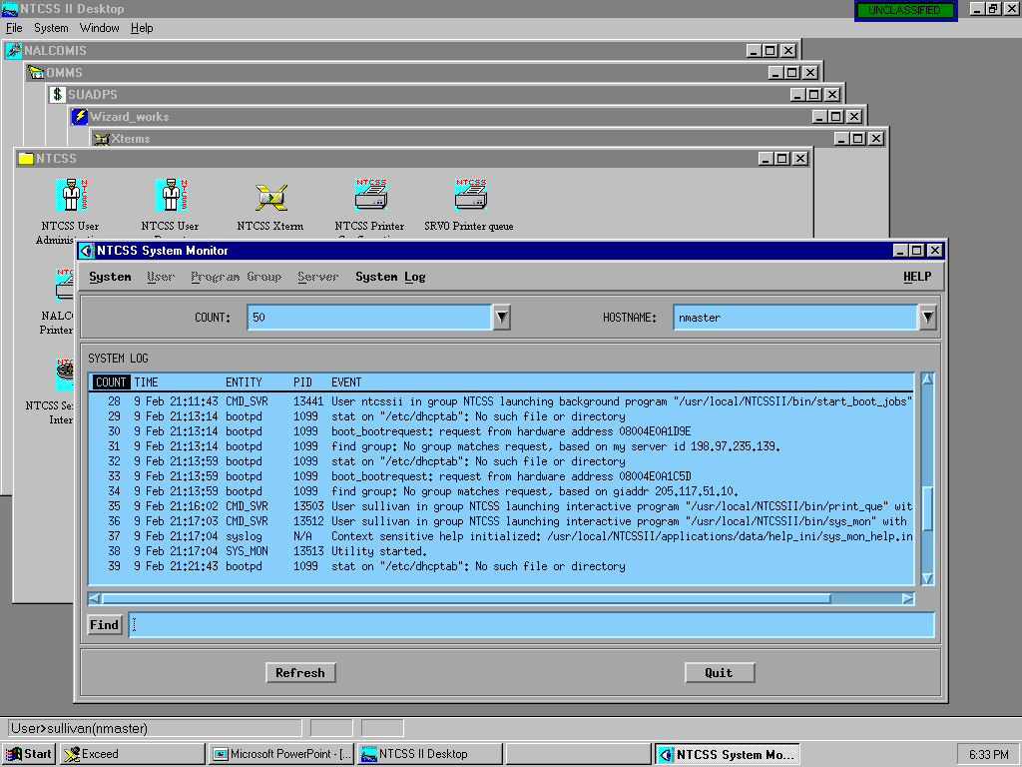
An audit log of selectable system events from the designated server

Slide 43
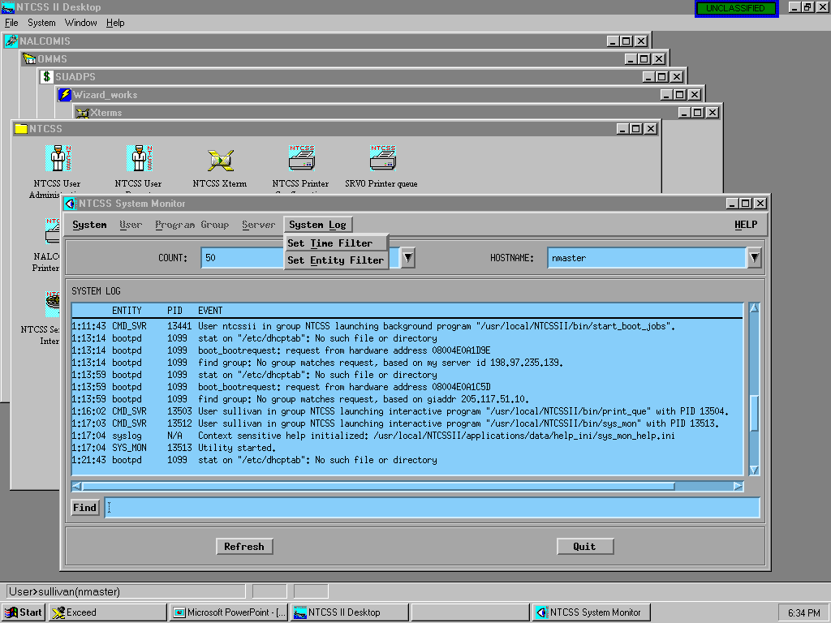
Audit filters for time span and event selection can be used to customize the log display as required

Slide 44
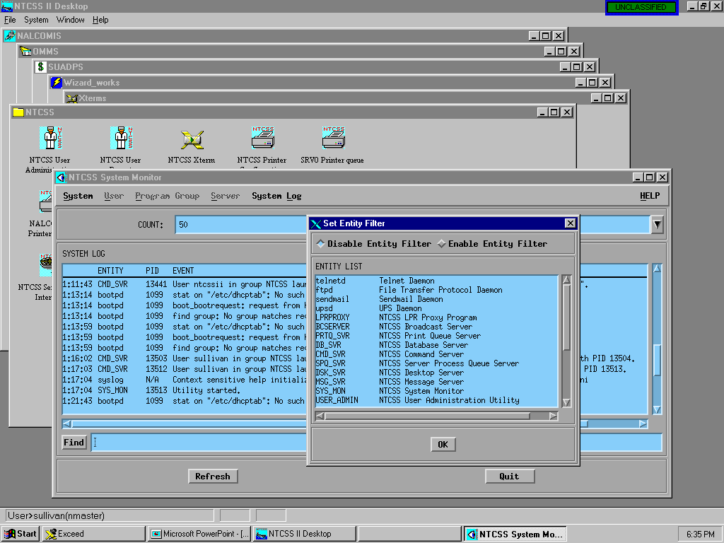
The “entity” filter selector

Slide 45
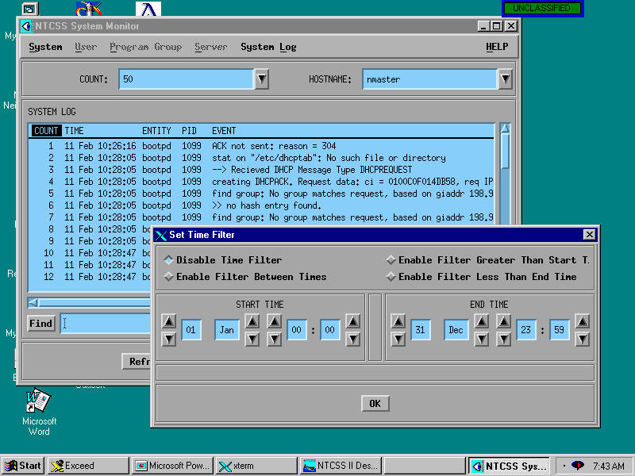
Setting the time filter

Slide 46
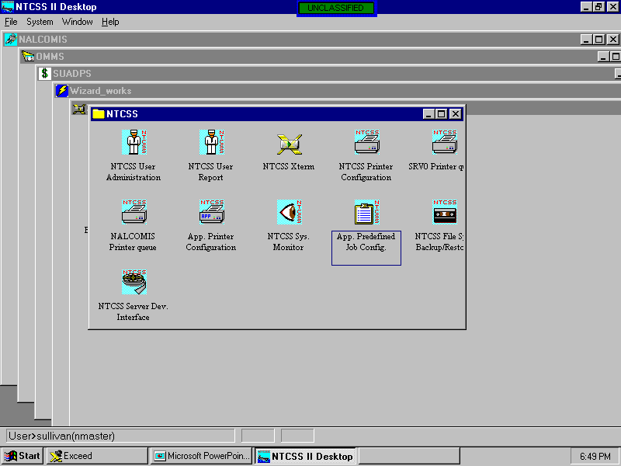
Starting the “Application Predefined Job” application

Slide 47
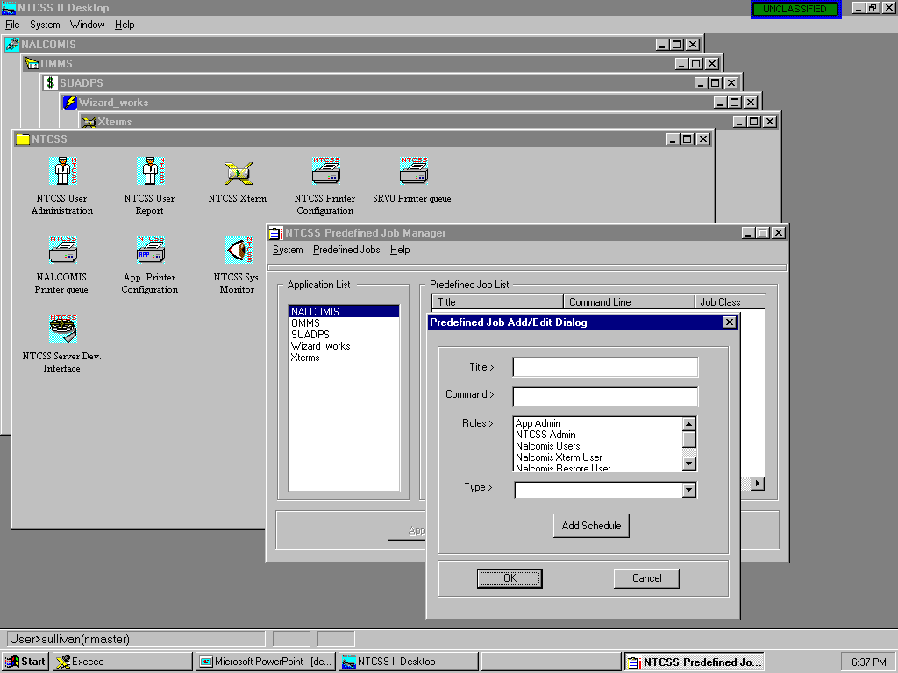
Server jobs may be defined by the “Application Administrator” and made available to users with certain “roles”

Slide 48
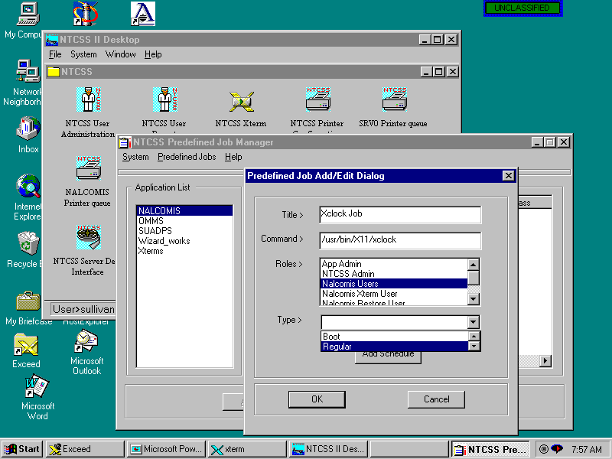
A job titled “Xclock Job” is built, executable by those users
with the “Nalcomis Users” role, and is classified as a “Regular”
job (vice “boot”). This job has no attached “schedule”.

Slide 49
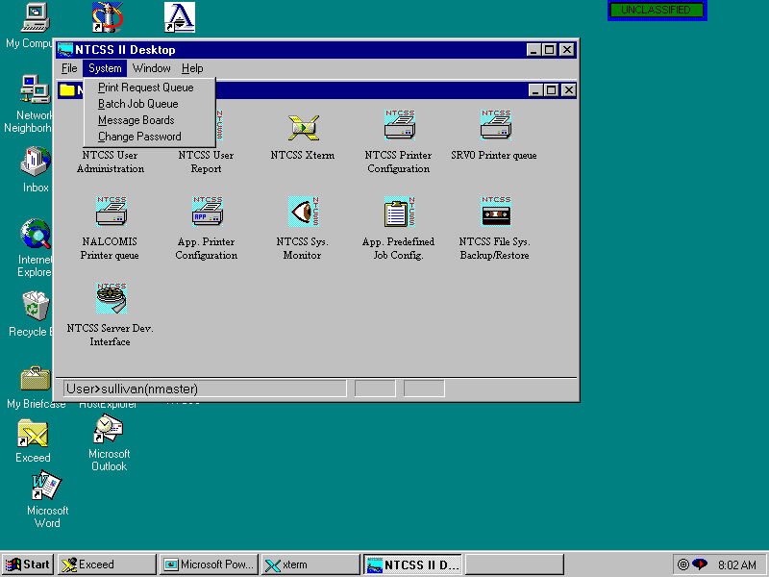
The “Batch Job Queue” will now be selected to
execute the “new job”.

Slide 50
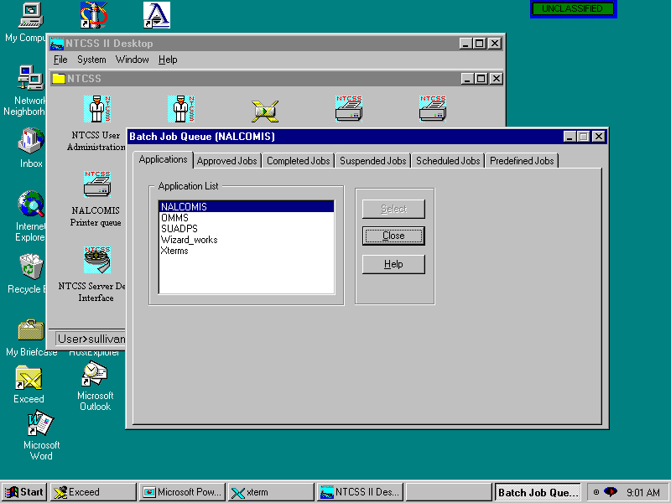
The application “NALCOMIS” is selected and the various classes of Server jobs are made available for selection via “tabs”

Slide 51
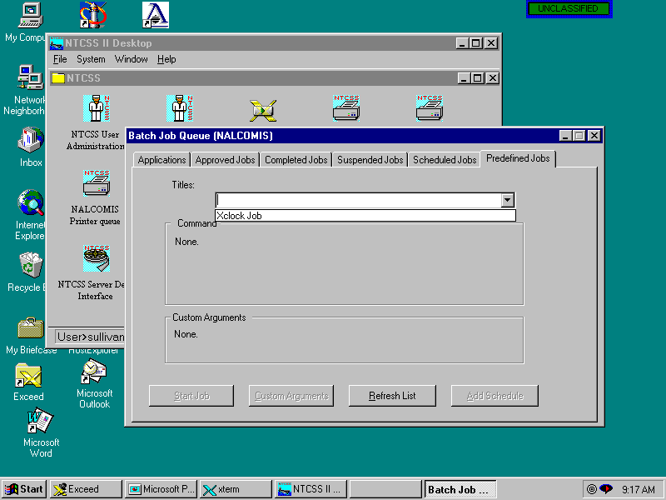
The “Predefined Jobs” tab is selected and the “Xclock Job” created previously can now be selected for execution.

Slide 52
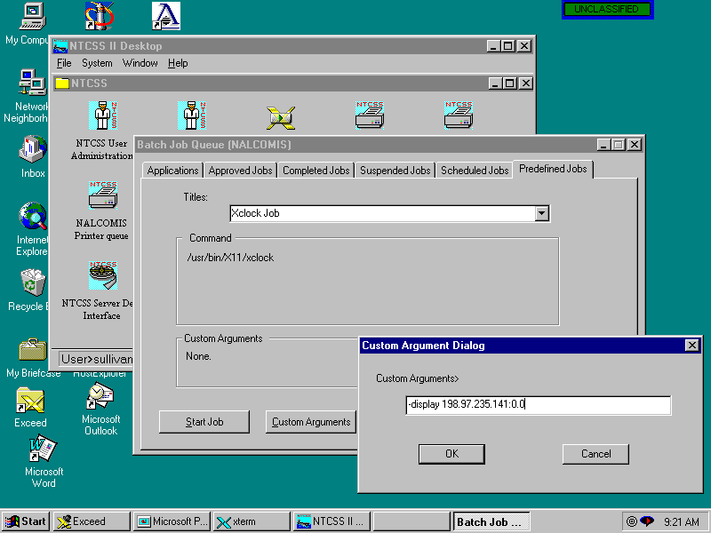
“Custom Arguments” can also be attached
to the command line at execution run-time.
Here, the IP address for xclock is added.

Slide 53
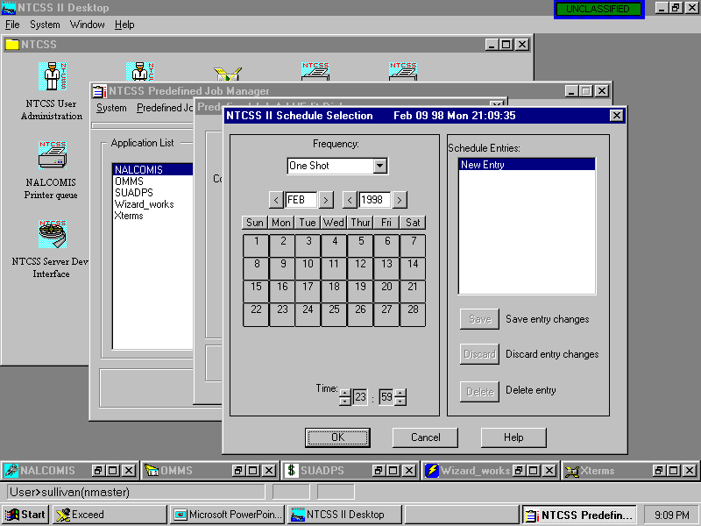
Schedules may also be attached to the jobs

Slide 54

The job can now be executed
with the “Start Job” button.

Slide 55

The job executing.

Slide 56

Selecting the “File system backup and restore” program

Slide 57

Selecting which host to backup/restore

Slide 58

Selecting tape drives, and backup jobs

Slide 59

A backup job may be added, or edited as required with automatic backup scheduling if required

Slide 60

First the “job” is given a name,
archive name, and an e-mail address
to which will be sent a full listing of
the backup results. Other types of
listings could be “only errors”, etc.
The Backup is automatic, each day
at 0000. (12 midnight)

Slide 61

When the “Add” button is clicked, directories and files can be selected for backup.

Slide 62

Here, the /etc/group file has been added to the backup profile for this job.

Slide 63

Additionally, the passwd file is added
to the selection.
Here, the passwd file is added to
the backup selection.

Slide 64

The backup job can now be selected and
the “Backup” button clicked to perform
an immediate backup if desired

Slide 65

If “OK” is clicked, an immediate backup of
the selected files is performed (in this case,
to the selected “4 mm DAT” tape drive.)

Slide 66

Selecting the “Server Device Interface” icon for execution

Slide 67

Selecting a server for operation

Slide 68

Different tape drives and tape formats can be chosen as required for input-output

Slide 69

Some basic desktop functionality, selecting the “Print Request Queue” manager

Slide 70

The “Print queue manager” program

Slide 71

Selecting the “Batch Job Queue” Manager

Slide 72

Various applications can be selected with “tabs” to select the display requirements of server “batch” jobs

Slide 73

Now leaving NT-CSS

Slide 74

Are you sure?

Slide 75

Back to about where we started...

